Slide 1
A.I replacing jobs/ Universal Basic Income (UBI)

Slide 2
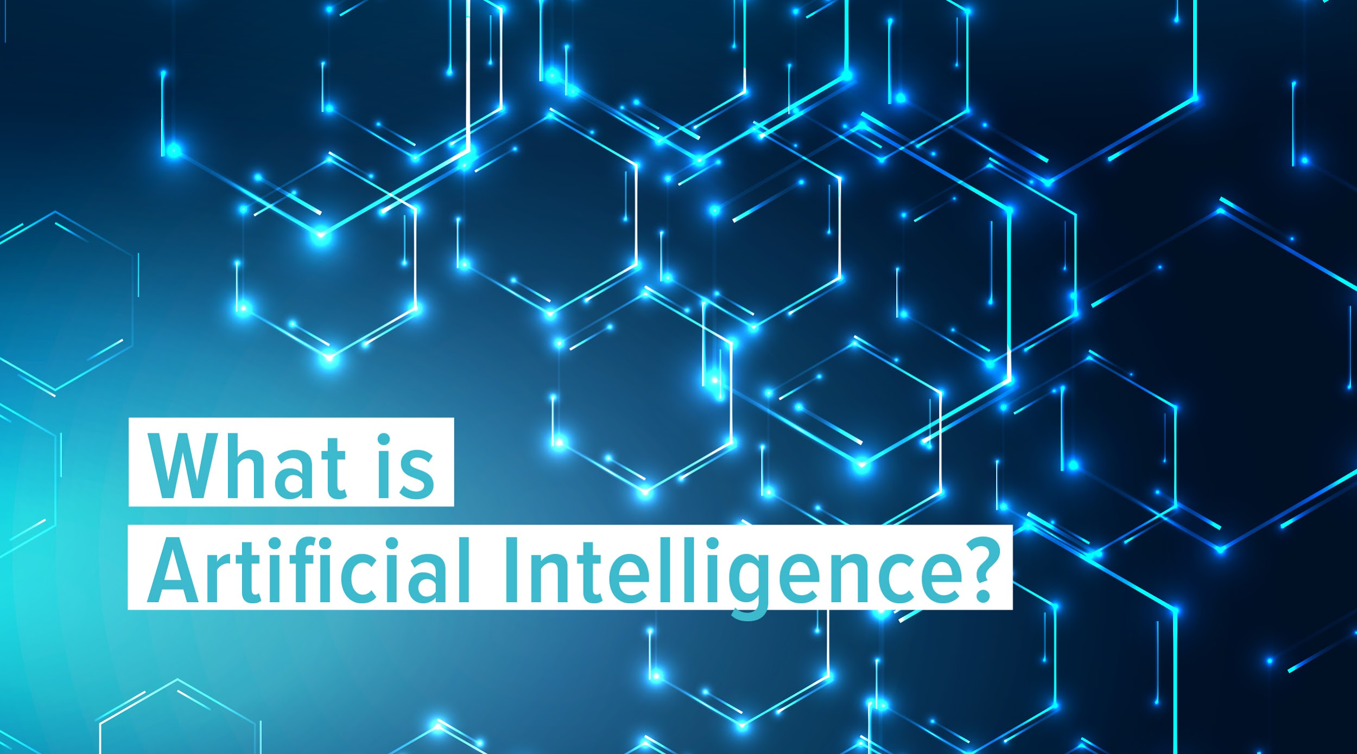
Intro to (A.I)
AI or artificial intelligence is the simulation of human intelligence processes by machines, especially computer systems. These processes include analyzing data, solving or anticipating problems for learning, reasoning and self-correction. Some of the wide applications of AI include expert systems, social media, smart home devices, (like Alexa), to some of the most recent breakthroughs in tech that being facial and speech recognition. Essentially there's 4 types of A.I so there's reactive machines, limited memory, theory of mind and self awareness but only the last 2 can be considered true A.I because theyre as close as they get to assimilating human intelligence that learn from their mistakes and their past experiences.

Slide 3
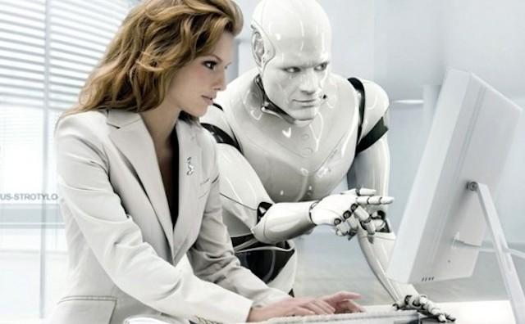
In what ways can A.I benefit us
. (A.I) eliminates the necessity for humans to perform tedious tasks. Artificial Intelligence can also be considered a boon to humanity given the fact that it allows humans to perform tasks in which they most excel at, so for now atleast it doesnt seem to be deem a threat to our existence since it has actually improved our lifestyles significantly compared to how people lived back then during the 20th century. According to a
study by Accenture, “Artificial intelligence has the ability to increase productivity by 40% or more. Through data collection, automation, decision making, and cybersecurity, AI can boost profitability by an average of 38%. This can help free up valuable time for employees.”

Slide 4
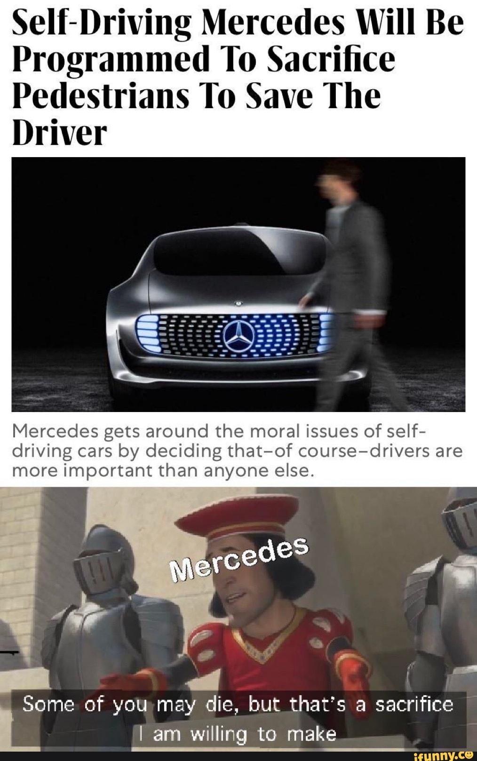
The moral dilemma of A.I replacing
human jobs
Now theres no doubt that robots could do certain jobs better than we do but would that really be the best thing to implement in a near future? Because in the reality in which we are living in where robots can do so many unwanted jobs that few people actually enjoy doing would that somehow change the appreciation we have for life. I'll let you answer that for yourselves. Also if most jobs are distribited amongst AI instead of humans then only tech companies and AI specialists would be receiving most of the revenue of the working facilities, in doing so creating inequality in the process when trying to create a fair-post labour economy. Another issue is artificial errors. When a robot is taught to judge by logic, how exactly do we clarify what's a mistake and what's not. For example, if a self-driving car is met with the choice of running over a pedestrian or severely harming the passengers within the vehicle, which will it choose? And who would be there to blame, the company who provided the driving services or the company responsible for the car's programming?

Slide 5
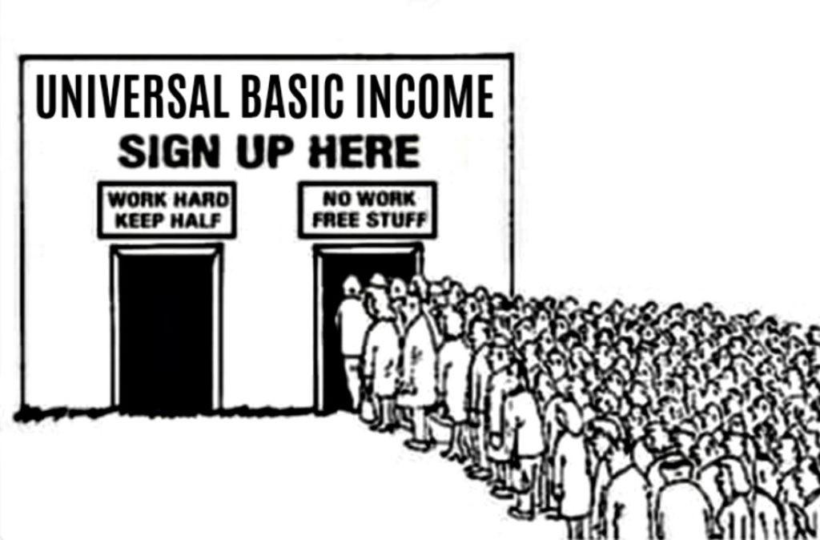
Universal Basic Income
With the increasing amount of A.I labour that's yet to be seen unemployment rates will continue to be more consistent than ever due to automation and the rich will continue to profit even more meanwhile the low class will grow in straight correlation to that. Famous entrepreneurs such as Elon Musk have proposed a solution to prevent mass impoverishment from occurring with one form of singular currency for the entire world known as Universal Basic Income (UBI). But would UBI really strive for economic equality? Commentary: Universal Basic Income May Sound Attractive But, If It Occurred, Would Likelier Increase Poverty Than Reduce It by Robert Greenstein wrote the following, “There are over 300 million Americans today. Suppose UBI provided everyone with $10,000 a year. That would cost more than $3 trillion a year and $30 trillion to $40 trillion over ten years.” That leaves us citizens to wonder who will provide the funds for for this new currency and it would most likely come from our taxes.

Slide 6
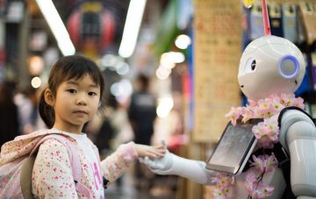
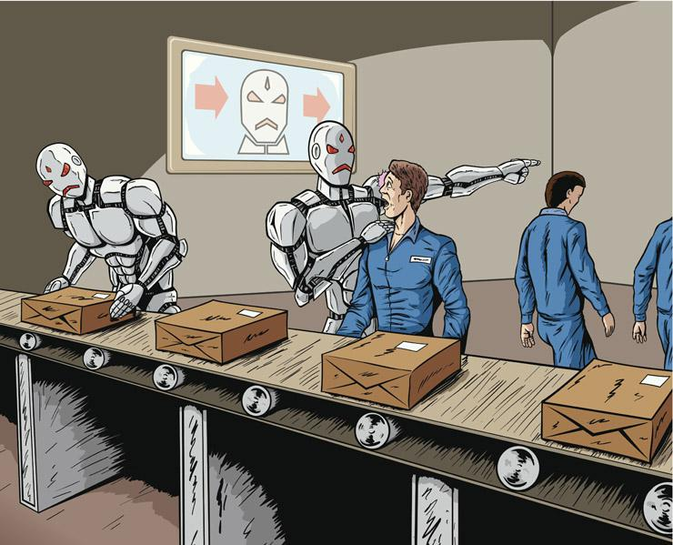
Conclusion
There's so many things yet to see and only time will tell if A.I will keep improving our lifestyles as it has done so far or maybe take a drastic change for worse but what we do know with certainty is that A.I will become even smarter and who knows maybe even develop their own consciousness one day. The only thing left to ask is, will we be able to coexist with intelligent beings apart from us?

